Slide 1

Foundation PHYSICS
Seminar 3: Energy, momentum, Circular motion and SHM

Slide 2
Learning outcomes
Students are expected to understand the concepts and resolve the following mechanical problems in relation to:
Circular Motion
Simple Harmonic Motion
Momentum and Conservation of Momentum

Slide 3
Practice Questions
At what point in the motion of a simple pendulum is (a) the tension in the string greatest, (b) the string tension least, (c) the radial acceleration greatest, (d) the speed greatest?
A mass attached by a light spring to the ceiling of an elevator oscillates vertically while the elevator ascends with constant acceleration. Is the period greater than, less than, or the same as when the elevator is at rest? Why?

Slide 4
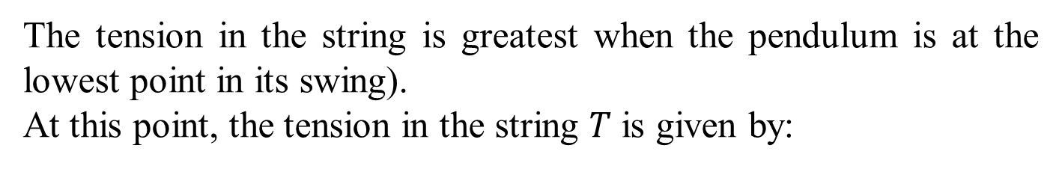
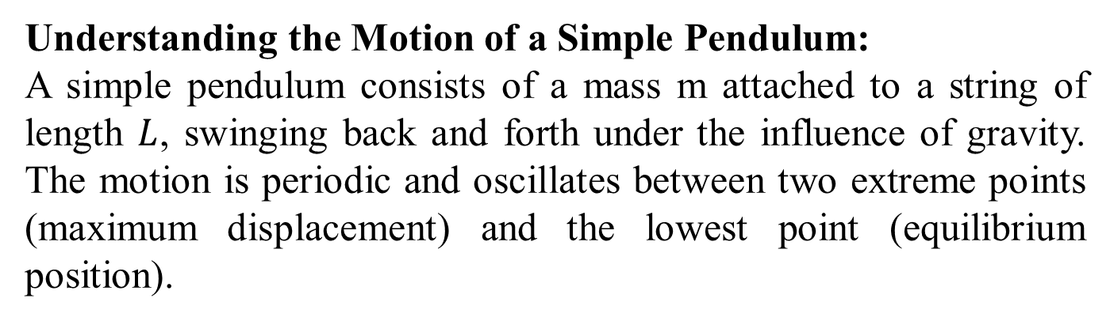
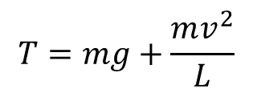
ANSWER: Practice Question 1
Understanding the Motion of a Simple Pendulum:
A simple pendulum consists of a mass m attached to a string of length $L$, swinging back and forth under the influence of gravity. The motion is periodic and oscillates between two extreme points (maximum displacement) and the lowest point (equilibrium position).
(a) The Tension in the String is Greatest:
The tension in the string is greatest when the pendulum is at the lowest point in its swing).
At this point, the tension in the string $T$ is given by:
$$T=mg+\frac{mv^{2}}{L}$$
Here, 𝑣 is the speed of the mass, which is greatest at the lowest point. Therefore, the tension is maximized at this point.

Slide 5

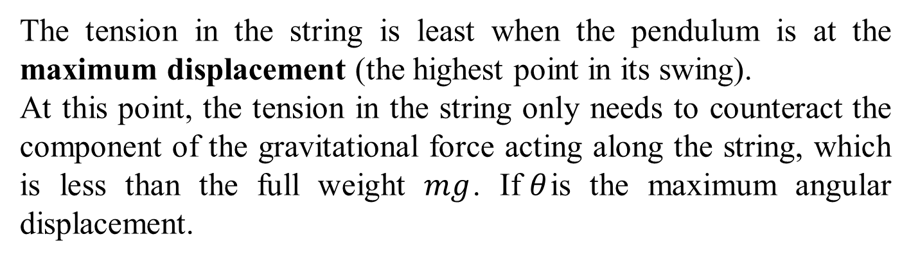
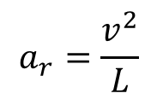
ANSWER: Practice Question 1
(b) The Tension in the String is least:
The tension in the string is least when the pendulum is at the maximum displacement (the highest point in its swing).
At this point, the tension in the string only needs to counteract the component of the gravitational force acting along the string, which is less than the full weight $mg$. If$θ$is the maximum angular displacement.
$$T=mg∙cosθ$$
(c) The Tension in the String is Least:
Radial acceleration (centripetal acceleration) is greatest at the lowest point in its swing given that​ is given by:
$$a_{r}=\frac{v^{2}}{L}$$

Slide 6
ANSWER: Practice Question 1
(d) The Speed is Greatest:
The speed of the pendulum is greatest at the lowest point in its swing
This is because all of the potential energy at the maximum displacement is converted into kinetic energy at the lowest point. The kinetic energy (and hence the speed) is maximized here.

Slide 7

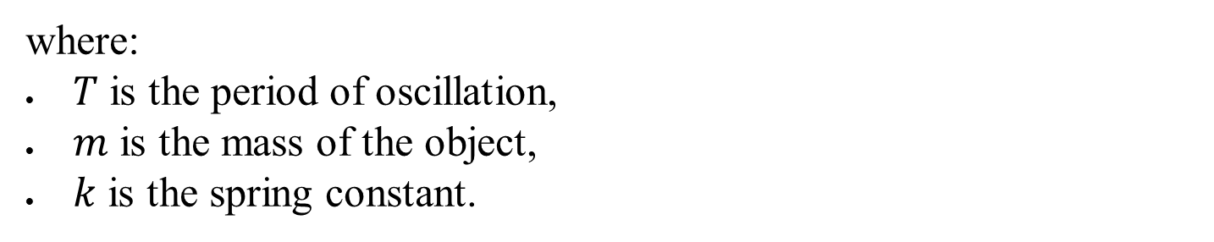
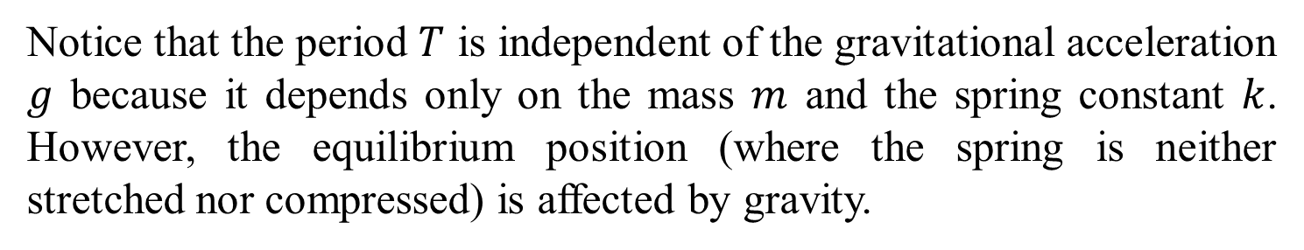
ANSWER: Practice Question 2
Understanding the Mass-Spring System:
The period of oscillation for a mass-spring system is given by:
$$T​ =2π\sqrt{\frac{m}{k}}$$
where:
$T$ is the period of oscillation,
$m$ is the mass of the object,
$k$ is the spring constant.
Notice that the period $T$ is independent of the gravitational acceleration $g$ because it depends only on the mass $m$ and the spring constant $k$. However, the equilibrium position (where the spring is neither stretched nor compressed) is affected by gravity.

Slide 8

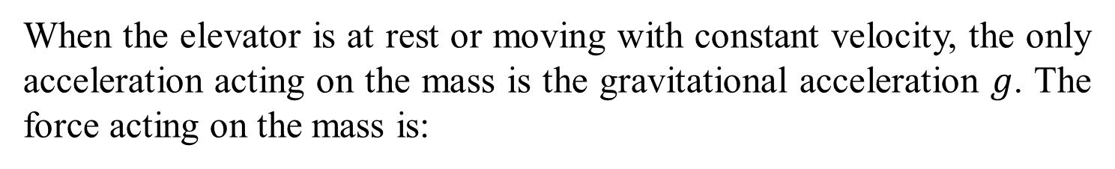


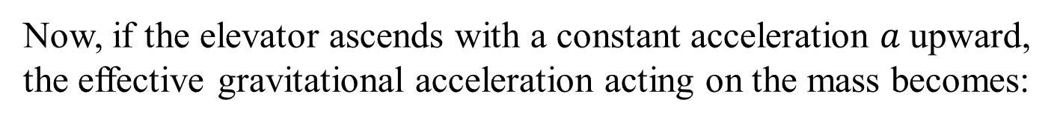
ANSWER: Practice Question 2
Case 1: Elevator at Rest
When the elevator is at rest or moving with constant velocity, the only acceleration acting on the mass is the gravitational acceleration $g$. The force acting on the mass is:
$$F_{gravity}=mg$$
This force causes the spring to stretch to a certain equilibrium position, but it does not affect the period of oscillation.
Case 2: Elevator Ascending with Constant Acceleration
Now, if the elevator ascends with a constant acceleration $a$upward, the effective gravitational acceleration acting on the mass becomes:
$g_{eff}= g + a$
This is because the upward acceleration of the elevator adds to the gravitational acceleration. The mass now experiences a greater force:
$$F_{effective}=m\left(a+g\right)$$

Slide 9
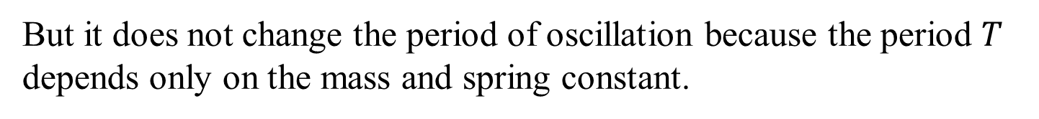

ANSWER: Practice Question 2
Case 2: Elevator Ascending with Constant Acceleration
This is because the upward acceleration of the elevator adds to the gravitational acceleration. The mass now experiences a greater force:
$$F_{effective}=m\left(a+g\right)$$
This increased effective gravitational force shifts the equilibrium position of the spring further down
But it does not change the period of oscillation because the period $T$ depends only on the mass and spring constant.

Slide 10
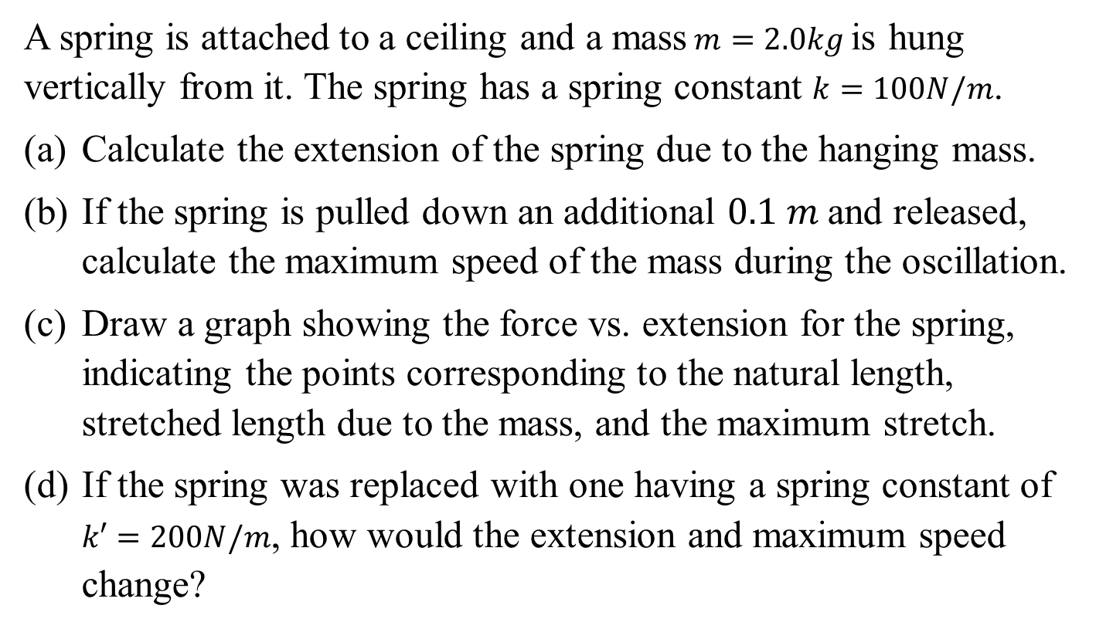
Question 1
A spring is attached to a ceiling and a mass$m=2.0kg$is hung vertically from it. The spring has a spring constant $k=100N/m$.
Calculate the extension of the spring due to the hanging mass.
If the spring is pulled down an additional $0.1 m$and released, calculate the maximum speed of the mass during the oscillation.
Draw a graph showing the force vs. extension for the spring, indicating the points corresponding to the natural length, stretched length due to the mass, and the maximum stretch.
If the spring was replaced with one having a spring constant of $k′=200N/m$, how would the extension and maximum speed change?

Slide 11
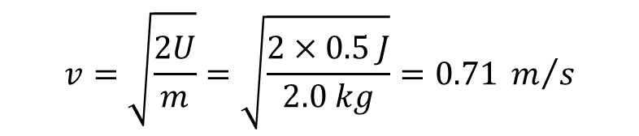
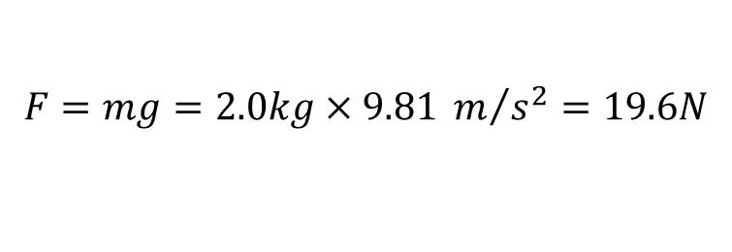
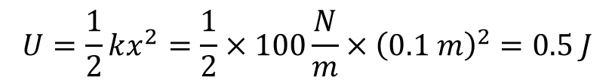

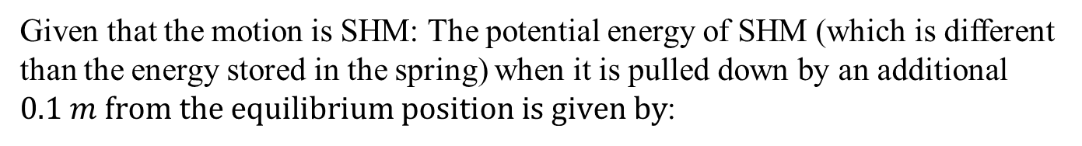
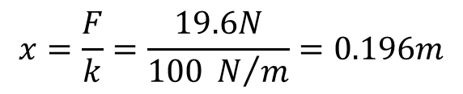
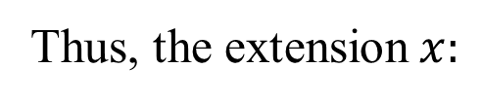
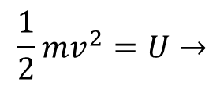
Question 1: ANSWERS
(a) Extension Calculation
By Hooke’s Law:
$$F=k∙x$$
The force due to gravity on the mass:
$$F=mg=2.0kg×9.81 m/{s^{2}}=19.6N$$
Thus, the extension$x:$
$$x=\frac{F}{k}=\frac{19.6N}{100 N/m}=0.196m$$
(b) Maximum Speed Calculation
Given that the motion is SHM: The potential energy of SHM (which is different than the energy stored in the spring) when it is pulled down by an additional $0.1 m from the equilibrium position is given by$:
$$U=\frac{1}{2}kx^{2}=\frac{1}{2}×100\frac{N}{m}×{\left(0.1 m\right)}^{2}=0.5 J$$
This potential energy is converted to kinetic energy at the equilibrium point:
$$v=\sqrt{\frac{2U}{m}}=\sqrt{\frac{2×0.5 J}{2.0 kg}}=0.71 m/s$$
$$\frac{1}{2}mv^{2}=U→$$

Slide 12
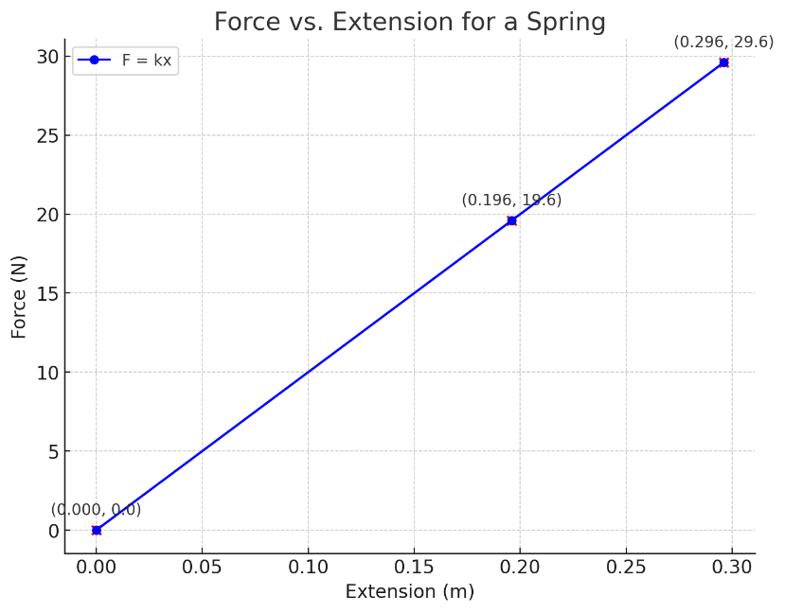
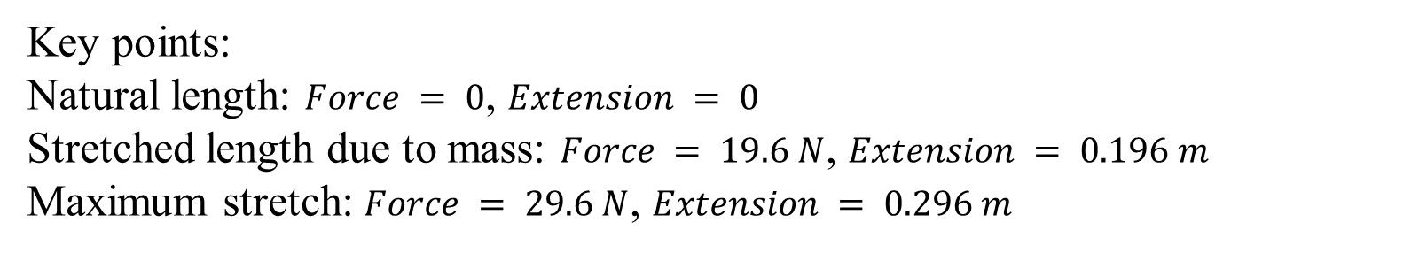
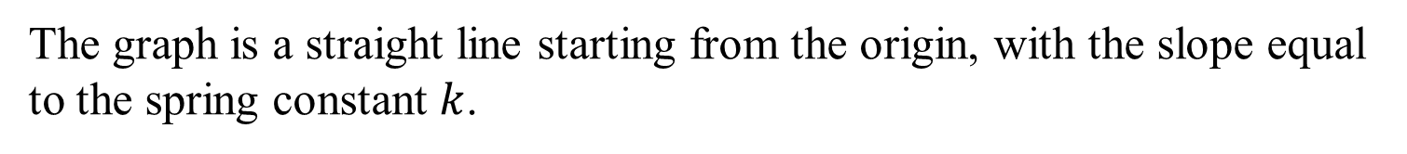
Question 1: ANSWERS
(c) Force vs. Extension Graph
The graph is a straight line starting from the origin, with the slope equal to the spring constant $k$.
Key points:
Natural length: $Force = 0$, $Extension = 0$
Stretched length due to mass: $Force = 19.6 N$, $Extension = 0.196 m$
Maximum stretch: $Force = 29.6 N$, $Extension = 0.296 m$

Slide 13
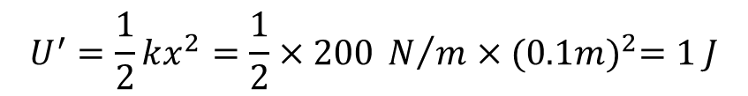
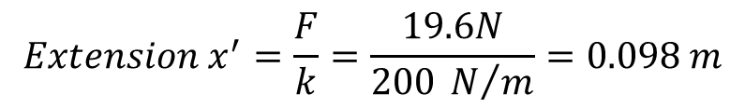
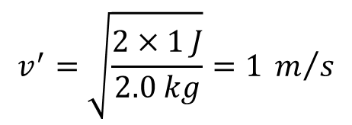
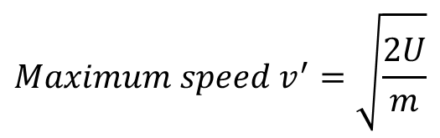
Question 1: ANSWERS
(d) Changes with New Spring Constant
$$Extension x^{′}=\frac{F}{k}=\frac{19.6N}{200 N/m}=0.098 m$$
𝑃𝑜𝑡𝑒𝑛𝑡𝑖𝑎𝑙 𝑒𝑛𝑒𝑟𝑔𝑦 𝑤𝑖𝑡ℎ 𝑛𝑒𝑤 𝑠𝑝𝑟𝑖𝑛𝑔 𝑐𝑜𝑛𝑠𝑡𝑎𝑛𝑡
$$U^{′}=\frac{1}{2}kx^{2}=\frac{1}{2}×200 N/m×{(0.1m)}^{2}=1 J$$
$$Maximum speed v^{′}=\sqrt{\frac{2U}{m}}$$
$$v^{′}=\sqrt{\frac{2×1 J}{2.0 kg}}=1 m/s$$

Slide 14
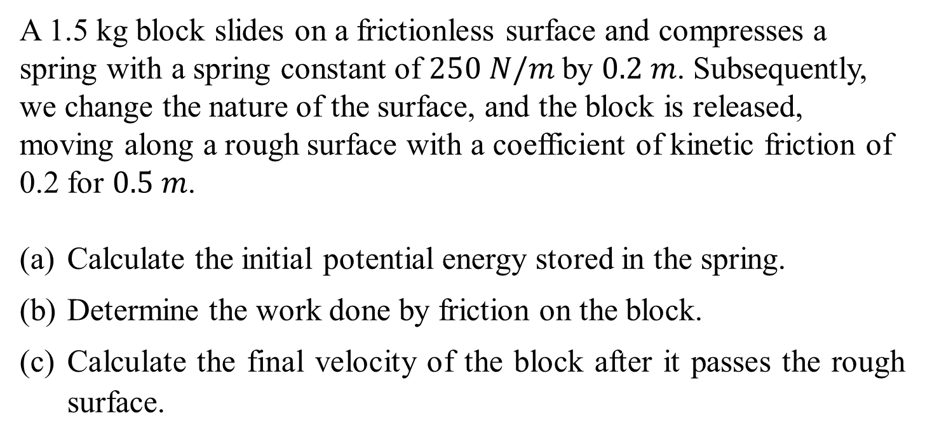
Question 2
A 1.5 kg block slides on a frictionless surface and compresses a spring with a spring constant of $250 N/m$by $0.2 m$. Subsequently, we change the nature of the surface, and the block is released, moving along a rough surface with a coefficient of kinetic friction of 0.2 for $0.5 m$.
Calculate the initial potential energy stored in the spring.
Determine the work done by friction on the block.
Calculate the final velocity of the block after it passes the rough surface.

Slide 15

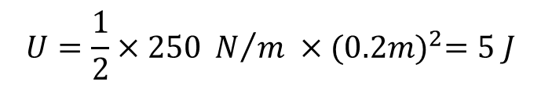

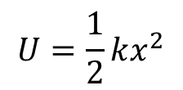
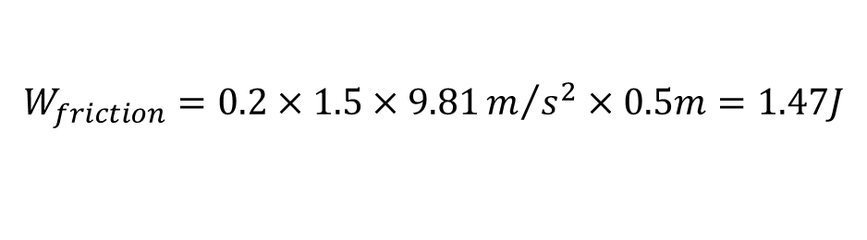

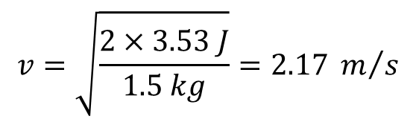

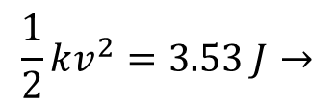
Question 2: ANSWERS
(a) Initial Potential Energy
$$U=\frac{1}{2}kx^{2}$$
$$U=\frac{1}{2}×250 N/m ×{(0.2m)}^{2}=5 J$$
(b) Work Done by Friction
$$W_{friction}=f_{k}×d$$
$$W_{friction} =μ_{k}×mg×d$$
$$W_{friction}=0.2×1.5×9.81m/{s^{2}}×0.5m=1.47J$$
(c) Final Velocity
Kinetic energy after spring releases
$$K=U−W_{friction}$$
$$K=5 J−1.47 J=3.53 J$$
Kinetic energy
$$v=\sqrt{\frac{2×3.53 J}{1.5 kg}}=2.17 m/s$$
$$\frac{1}{2}kv^{2}=3.53 J→$$

Slide 16
Question 3
A 0.5 kg ball moving at 4 m/s collides with a 1 kg ball at rest. After the collision, the 0.5 kg ball moves at 2 m/s at the same direction.
Calculate the velocity of the 1 kg ball after the collision.
Determine the impulse experienced by the 1 kg ball.
Check whether the collision is elastic .

Slide 17



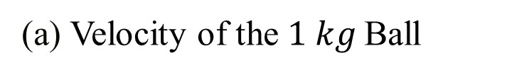
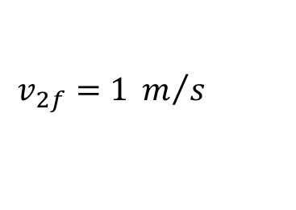
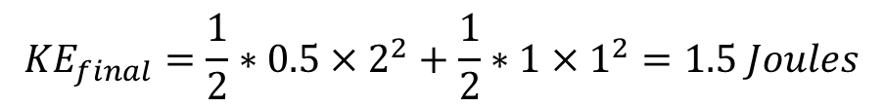

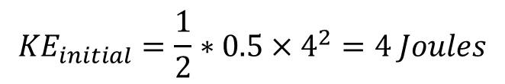

Question 3: ANSWERS
(a) Velocity of the $1 kg$Ball
$$m_{1}v_{1i}+m_{2}v_{2i}=m_{1}v_{1f}+m_{2}v_{2f}$$
$$\left(0.5\right)×\left(4\right)+\left(1\right)×\left(0\right)=\left(0.5\right)\left(2\right)+\left(1\right)v_{2f}$$
$$2=1+v_{2f}$$
$$v_{2f}=1 m/s$$
Notice that this result is mathematically correct but for the previous configuration implies that the masses will collide again given that this speed is smaller than the speed of the first object.
(b) Impulse on 1 kg Ball
$$J=∆p$$
$$J =m_{2}×∆v$$
$$J=1×\left(1−0\right)=1N sec$$
(c) Check whether the collision is elastic:
$${KE}_{initial}=\frac{1}{2}∗0.5×4^{2}=4 Joules$$
Final momentum:
$${KE}_{final}=\frac{1}{2}∗0.5×2^{2}+\frac{1}{2}∗1×1^{2}=1.5 Joules$$
Given that ${KE}_{initial}≠{KE}_{final}$, the collision is inelastic.

Slide 18
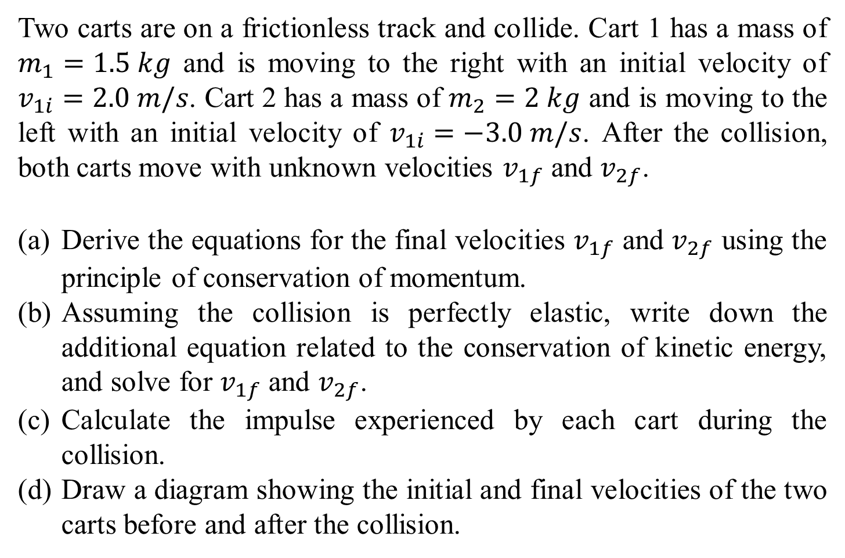
Question 4
Two carts are on a frictionless track and collide. Cart 1 has a mass of $m_{1}=1.5 kg$ and is moving to the right with an initial velocity of $v_{1i}​=2.0 m/s$. Cart 2 has a mass of $m_{2}=2 kg$ and is moving to the left with an initial velocity of $v_{1i}​=−3.0 m/s$. After the collision, both carts move with unknown velocities $v_{1f}$ and $v_{2f}$.
Derive the equations for the final velocities $v_{1f}$ and $v_{2f}$ using the principle of conservation of momentum.
Assuming the collision is perfectly elastic, write down the additional equation related to the conservation of kinetic energy, and solve for $v_{1f}$ and $v_{2f}$.
Calculate the impulse experienced by each cart during the collision.
Draw a diagram showing the initial and final velocities of the two carts before and after the collision.

Slide 19


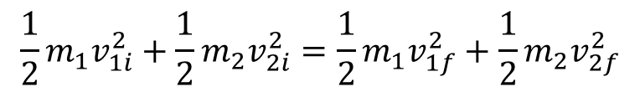



Question 4: ANSWERS
(a) Derive the Equations for Final Velocities
The law of conservation of momentum states:
$$m_{1}v_{1i}+m_{2}v_{2i}=m_{1}v_{1f}+m_{2}v_{2f}$$
Substituting the given values:
$$\left(1.5\right)×\left(2\right)+\left(2\right)×\left(−3\right)=1.5v_{1f}+2v_{2f}$$
$$3−6=1.5v_{1f}+{2v}_{2f}$$
$$−3=1.5v_{1f}+2v_{2f} Equation 1$$
(b) Conservation of Kinetic Energy
For a perfectly elastic collision, kinetic energy is conserved:
$$\frac{1}{2}m_{1}v_{1i}^{2}+\frac{1}{2}m_{2}v_{2i}^{2}=\frac{1}{2}m_{1}v_{1f}^{2}+\frac{1}{2}m_{2}v_{2f}^{2}$$
Substituting the given values:
$$\frac{1}{2}×1.5×{\left(2\right)}^{2}+\frac{1}{2}×2×{\left(−3\right)}^{2}=\frac{1}{2}×1.5×v_{1f}^{2}+\frac{1}{2}×2×v_{2f}^{2}$$
$$3+9=0.75v_{1f}^{2}+v_{2f}^{2}$$
$$12=0.75v_{1f}^{2}+v_{2f}^{2} Eqution 2$$

Slide 20


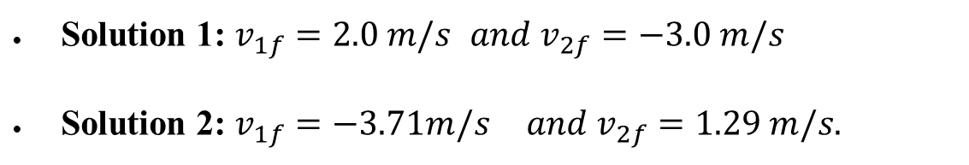
Question 4: ANSWERS
To solve for $v_{1f}$ and $v_{2f}$ use substitution or simultaneous equations:
$$−3=1.5v_{1f}+2v_{2f} Equation 1$$
$$12=0.75v_{1f}^{2}+v_{2f}^{2} Equation 2$$
By solving the system of equations you can find the final velocities
Solution 1: $v_{1f}​=2.0 m/s$ ${and v}_{2f}​=−3.0 m/s$
Solution 2: $v_{1f}​=−3.71m/s$ $and v_{2f}​=1.29 m/s.$
The first one is of no interest given that it describes the case that the two objects do not collide.

Slide 21





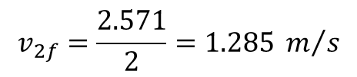
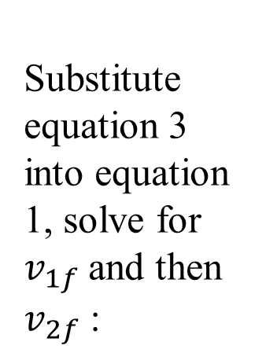


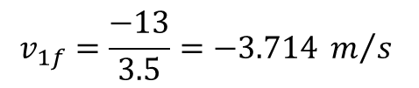
Question 4: ANSWERS
Alternatively: If you want to avoid solving the previous quadratic system in the case of elastic collisions you can combine equations 1 and 2 to derive the equation 3 (refer to book/theory):
$$v_{1i}+v_{1f}=v_{2i}+v_{2f} Equation 3$$
$$2+v_{1f}=−3+v_{2f}$$
$$v_{2f}=5+v_{1f}$$
Substitute equation 3 into equation 1, solve for $v_{1f}$and then $v_{2f}$:
$$−3={1.5v}_{1f}+2\left(5+v_{1f}\right)$$
$$−3={1.5v}_{1f}+10+2v_{1f}$$
$$−13=3.5v_{1f}$$
$$v_{1f}=\frac{−13}{3.5}=−3.714 m/s$$
$$−3=1.5\left(−3.714\right)+2v_{2f}$$
$$v_{2f}=\frac{2.571}{2}=1.285 m/s$$

Slide 22
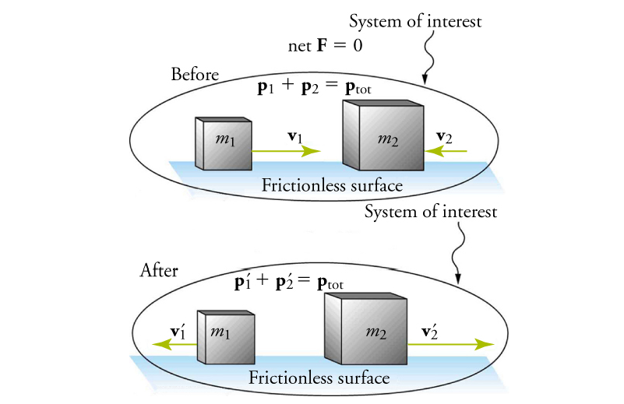
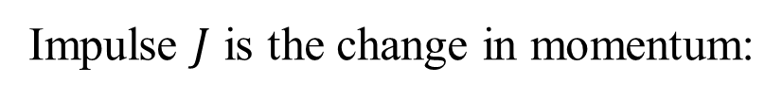
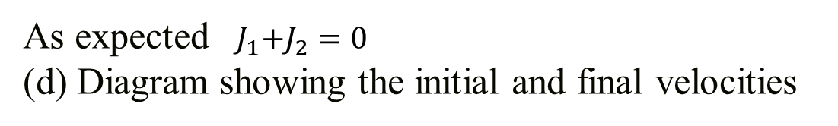
Question 4: ANSWERS
(c) Impulse experienced by each cart during the collision
Impulse $J$ is the change in momentum:
For Cart 1:
$$J_{1}=∆p=m_{1}×∆v=1.5×\left(−3.71−2\right)=−8.57 N$$
For Cart 2:
$$J_{2}=∆p=m_{2}×∆v=2×\left(1.285−(−3)\right)=8.57 N$$
As expected ${ J}_{1}+J_{2}=0$
(d) Diagram showing the initial and final velocities

Slide 23
Question 5
A car of mass 1500 kg is moving at a constant speed of 20 m/s around a circular track with a radius of 50 m.
Calculate the magnitude of the centripetal force acting on the car.
If the coefficient of friction between the tires and the road is 0.6, determine whether the frictional force is sufficient to keep the car on the circular path without skidding.
If the car were to move at a higher speed of 30 m/s, determine the new centripetal force required.
Explain what would happen to the car if it attempted to go around the curve at this higher speed and the frictional force is the same as in part (b).

Slide 24

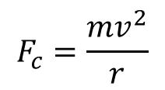

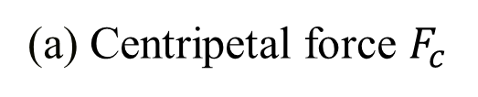
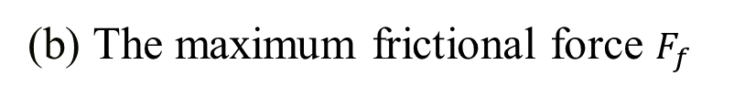

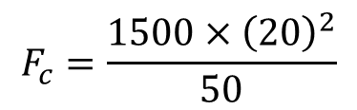

Question 5: ANSWERS
(a) Centripetal force $F_{c}$
$$F_{c}=\frac{mv^{2}}{r}$$
Substituting the values:
$$F_{c}=\frac{1500×{\left(20\right)}^{2}}{50}$$
$$F_{c}=12000 N$$
(b) The maximum frictional force $F_{f}$
$$F_{f}=μmg$$
Substituting the values:
$$F_{f}=0.6×1500×9.81$$
$$F_{f}=8829 N$$
Since $12000N>8820N$, the frictional force is not sufficient to keep the car on the path at $20 m/s$

Slide 25
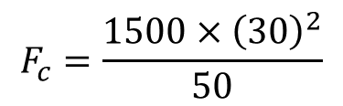



Question 5: ANSWERS
(c)The Centripetal Force $F_{c} is:$
$$F_{c}=\frac{1500×{\left(30\right)}^{2}}{50}$$
$$F_{c}=27000 N$$
(d) Explain what would happen to the car
If the car attempts to go around the curve at $30 m/s$, the required centripetal force $(27000 N)$far exceeds the available frictional force $(8829 N).$
Therefore, the car will skid outward due to insufficient friction to provide the necessary centripetal force.

Slide 26
Question 6
A simple pendulum has a length of 2 meters and is displaced to an angle of 15° from the vertical.
(a) Calculate the period of the pendulum.
(b) Determine the maximum speed of the pendulum bob during its motion.
(c) Explain how the period and maximum speed of the pendulum would change if the length of the pendulum were increased. Include diagrams to support your explanation.

Slide 27













Question 6: ANSWERS
(a) The period T of the pendulum
$$T=2π\sqrt{\frac{l}{g}}$$
The period $T$ of the pendulum is given by:
$$T=2π\sqrt{\frac{2}{9.81}}=2.84 s$$
Substituting the values:
(b) The maximum speed $v_{max}$​
The maximum speed $v_{max}$​ is given by:
$$v_{max}=ωA$$
Where $ω=\sqrt{\frac{g}{l}}$ and $A=l∙sinθ$. Substituting values:
$$v_{max}=\sqrt{\frac{9.81}{2}} ×\left(2∙sin15°\right)$$
$$v_{max}=\sqrt{\frac{g}{l}} ×\left(l∙sinθ\right)$$
$$v_{max}=1.15m/s$$
(c) length $l$ increases​
If the length $l$ increases, the period $T$ increases, and the maximum speed $v_{max}$ also increases as it is proportional to $\sqrt{l}$ as it can be seen from the above.

Slide 28
Question 7
Consider a simple pendulum with a bob of mass 0.2 kg that is released from a height of 0.5 m above the lowest point of the swing.
Calculate the potential energy of the pendulum bob at the highest point.
Determine the speed of the bob at the lowest point of the swing.
Describe the motion of the pendulum in terms of kinetic and potential energy conversion. Include a diagram showing the energy transformations.

Slide 29












Question 7: ANSWERS
(a) The potential energy PE
The potential energy PE at the highest point is given by
(assuming PE is zero at the lowest position of pendulum):
$$PE=mgh$$
Substituting the values:
$$PE=0.2×9.81×0.5=0.98 J$$
(b) The speed $v$ at the lowest point
The speed $v$ at the lowest point is found using energy conservation:
$$mgh=\frac{1}{2}mv^{2}→$$
$$gh=\frac{1}{2}v^{2}→$$
$$v=\sqrt{2gh}$$
$${PE}_{top}={KE}_{bottom}→$$
Solving for $v$:
$$v=\sqrt{2×9.81×0.5}=3.13 m/s$$
(c) Describe the motion of the pendulum
As the pendulum swings down, potential energy is converted into kinetic energy. At the lowest point, all potential energy is converted to kinetic energy.

Slide 30

Question 8
A 0.150 kg toy is undergoing SHM on the end of a horizontal spring with force constant k=10N/m. When the object is 0.0120 m from its equilibrium position, it is observed to have a speed of 0.3 m/s. Find:
the total energy of the object at any point in its motion,
the amplitude of the motion, and
the maximum speed attained by the object during its motion.
Given:
Mass of the toy, $m=0.150kg$
Displacement from equilibrium, $x=0.0120m$
Speed at this displacement, $v=0.300m/s$
Force constant of the spring, $k=10.0N/m$

Slide 31





Question 8: ANSWERS
(a) The Total Energy of the Object at Any Point in its Motion
The total mechanical energy$E$ in SHM is the sum of the kinetic energy $K$ and potential energy $U$. The total energy remains constant throughout the motion.
$$E=U+K=\frac{1}{2}kx^{2}+\frac{1}{2}mv^{2}$$
$$U=\frac{1}{2}×10 N/m×{\left(0.012 m\right)}^{2}=0.00072 J$$
$$K=\frac{1}{2}×0.150 kg×{\left(0.3 m/s\right)}^{2}=0.00675 J$$
$$E=0.00072 J+0.00675 J=0.00747 J$$
So, the total energy $E$ of the object at any point in its motion is:
$$E=0.00747 J$$

Slide 32








Question 8: ANSWERS
(b) The Amplitude of the Motion
The amplitude A of the motion is the maximum displacement from the equilibrium position. The total energy in SHM is also expressed as:
$$E=\frac{1}{2}kA^{2}$$
We can solve for $A$ using the total energy:
$$0.00747 J=\frac{1}{2}×10 N/m×A^{2}$$
$$A^{2}=\frac{0.00747 J}{5 N/m}=0.00149 m^{2}$$
$$A=\sqrt{0.00149 m^{2}}$$
$$A=0.0387m$$
So, the amplitude $A$ of the motion is:
$$0.0387 m$$

Slide 33








Question 8: ANSWERS
(b) The Maximum Speed Attained by the Object During its Motion
The maximum speed $v_{max}$occurs when the object passes through the equilibrium position $x=0$, where all the energy is kinetic:
$$E=\frac{1}{2}mv^{2}$$
$$0.00747 J=\frac{1}{2}×0.150kg×v_{max}^{2}$$
$$v_{max}^{2}=\frac{0.00747 J}{0.075 kg}=0.0996 {m^{2}}/{s^{2}}$$
$$v_{max}^{2}=\sqrt{0.0996 {m^{2}}/{s^{2}}}$$
$$v_{max}=±0.315 m/s$$
So, the maximum speed $v_{max}$​ attained by the object during its motion is:
$$±0.315 m/s$$

Slide 34
Q&A? Office hours:

Slide 35

Question 9: Extension
A uniform steel beam has a mass of 940 kg. On it is resting half of an identical beam, as shown in the figure. What is the vertical support force at each end?

Slide 36






Question 9: ANSWERS
The centre of gravity of each beam is at its geometric center.
Calculate torques about the left end of the beam, and take counterclockwise torques to be positive.
The conditions of equilibrium for the beam are used to find the forces that the support exerts on the beam
$$\sum{τ=F_{B}l−Mg\left(l/2\right)−\left(\frac{1}{2}Mg\right)\left(l/4\right)=0}$$
$$F_{B}=\frac{5}{8}Mg=\frac{5}{8}\left(940 kg\right)(9.81 m/{s^{2})=5763 N}$$
$$\sum{F_{y}}=F_{A}+F_{B}−Mg−\frac{1}{2}Mg=0$$
$$F_{A}=\frac{3}{2}Mg−F_{B}$$
$$F_{A}=\frac{7}{8}(940 kg)(9.81m/{s^{2})=8069 N}$$

Slide 37

Question 10: Extension
A 0.0125 kg bullet strikes a 0.240 kg block attached to a fixed horizontal spring whose spring constant is $2.25×{10}^{3} N/m$and sets it into oscillation with an amplitude of 12.4 cm. What was the initial speed of the bullet if the two objects move together after impact?

Slide 38






Question 10: ANSWERS
$$E=\frac{1}{2}kA^{2}=\frac{1}{2}{mv}_{max}^{2}$$
$$E=\frac{1}{2}kA^{2}=\frac{1}{2}{\left(m+M\right)v}_{max}^{2}$$
$$v_{max}=A\sqrt{k/{(m+M)}}$$
This speed is the speed that the block and bullet have immediately after the collision. Linear momentum in one dimension will have been conserved during the (assumed short time) collision, and so the initial speed of the bullet can be found.
$$v_{0}=\frac{(m+M)v_{max}}{m}$$
$$p_{before}=p_{after}→mv_{0}=(m+M)v_{max}$$
$$v_{0}=\left(\frac{m+M}{m}\right)\left(A\sqrt{\frac{K}{m+M}}\right)$$
$$v_{0}=\left(\frac{0.2525 kg}{0.0125 kg}\right)\left(\left(0.124 m\right)\sqrt{\frac{2250N/m}{0.2525 kg}}\right)=236 m/s$$

Slide 39


Question 11: Extension
Construct a Table indicating the position x of the mass in the figure below at times$t=0, 1/4T,1/2T,3/4,T and5/4T$, where T is the period of oscillation of the mass spring system seen below.
.

Slide 40


Question 11: ANSWERS
The Table of data is shown, along with the smoothed graph.
Every quarter of a period, the mass moves from an extreme point to the equilibrium.
The graph resembles a cosine wave (actually, the opposite of a cosine wave).

